Slide 1
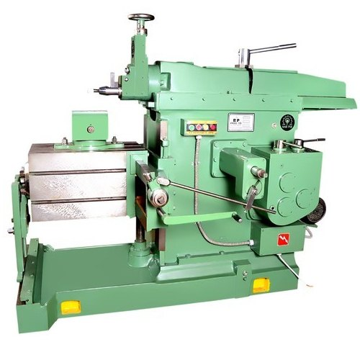
SHAPER, PLANER & SLOTTER

Slide 2
SHAPER
The shaper is a reciprocating type of machine tool primarily used to produce flat surfaces. These surfaces may be horizontal, vertical or inclined.
A shaper is a type of machine tool that uses linear relative motion between the work piece and a single-point cutting tool to machine a linear tool path.

Slide 3
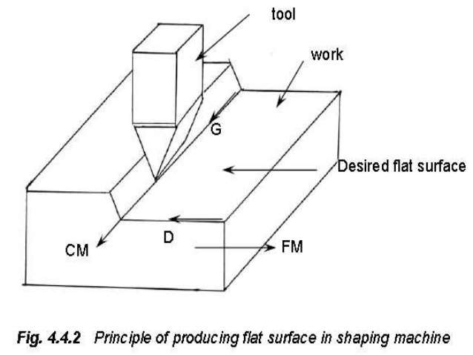

Slide 4
The tool reciprocates over the work. During the forward stroke of the tool, it removes metal from work piece. At the end of return stroke the operator has to move the table and work to the desired amount.
Relatively skilled workers are required to operate shapers and planers, and most of the shapes that can be produced on them also can be made by much more productive processes, such as milling, broaching, or grinding.

Slide 5
Feed Mechanism :
Table feed is intermittent and is accomplished on the return (non cutting) stroke when the tool has cleared the workpiece.
The cross feed is given to the table with the help of a cross feed screw which is actuated by a pawl which engages a notched wheel (ratchet) keyed to the screw.

Slide 6
Classification of Shaper Machine :
1. According to the type of mechanism used for giving reciprocating motion to the ram:
(a) Crank type (b) Geared type (c) Hydraulic type
2. According to the position and travel of ram:
(a) Horizontal type (b) Vertical type (c) Traveling head type
3. According to the type of cutting stroke:
(a) Push type (b) Draw / pull type

Slide 7
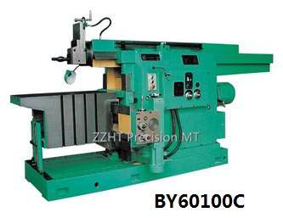
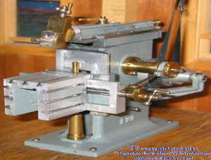
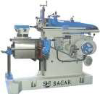
Crank shaper: Shapers whose ram reciprocates with the help of a crank mechanism
Geared shaper: The ram reciprocates with spur gear mechanism. This type of shaper carries a rack under the ram for to and fro motion.
Hydraulic shaper: The movement of the ram is provided by hydraulic pressure.

Slide 8
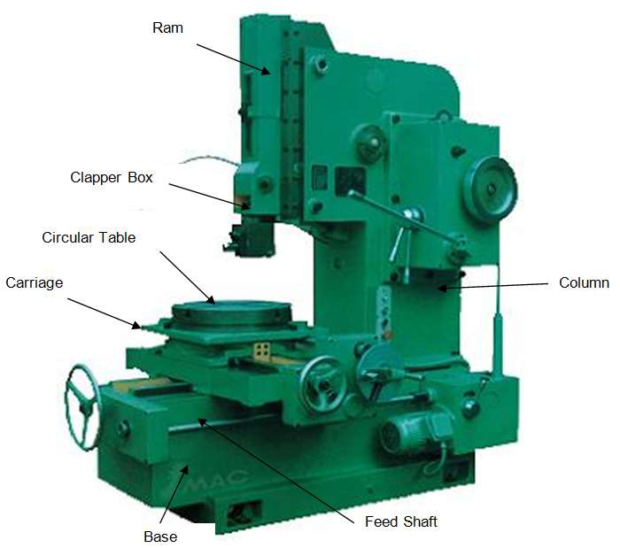
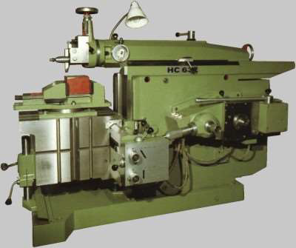
Horizontal shaper: The ram reciprocates in horizontal direction.
Vertical shaper: The ram reciprocates in vertical direction. It is also known as slotter.

Slide 9
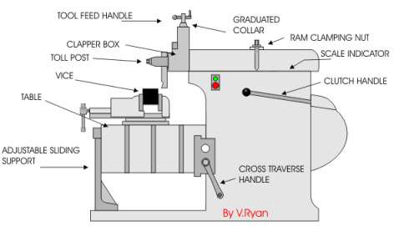
Parts of Shaper:

Slide 10
Base: The base is the necessary bed or support required for all machine tools. It is so designed that it can take up the entire load of the machine and the forces setup by the cutting tool over the work. It is made of cast iron to resist vibration and take up high compressive load.
Ram: The ram is the reciprocating member of the shaper. It slides on the accurately machined dovetail guide ways on the top of the column and is connected to the reciprocating mechanism contained within the column.
Tool head: The tool head of a shaper, holds the tool rigidly, provides vertical and angular feed movement of the tool and allows the tool to have an automatic relief during its return stroke.
TABLE- It is a void container casting by machined T-slots on the top and sides. Vice is generally fixed on the top of the table to hold workpiece.

Slide 11
CLAPPER BOX- The shaping machine usually cuts on the forward stroke and does not on the backward stroke. So it is not required for the tool to be in contact with the work piece when it is on the backward stroke. This is ensured by the Clapper box, a device which is hinged to the ram. The lifting of the cutting tool by the clapper box ensures longer tool life and also avoids accidental scratch or other machining defects on the work piece/final product.
CROSS RAIL- It permits vertical and horizontal movement of table. Cross feed mechanism is attached to cross rail.
SADDLE- It carries the work table. Crosswise movement of saddle causes the work table to move sideways.

Slide 12
Application :
To machine straight, flat surfaces.
Keyways in the boss of a pulley or gear can be machined.
Dovetail slides.
Internal spines.
Cutting Slots, grooves and keyways.

Slide 13
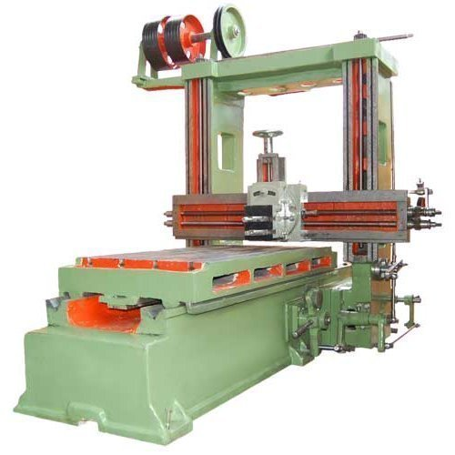
PLANER

Slide 14
Planing can be used to produce horizontal, vertical, or inclined flat surfaces by using single point cutting tool on workpieces that are too large to be accommodated on shapers.
The basic difference between planer & shaper is , in planer , the tool remains stationary & the work reciprocate whereas in shaper, the tool reciprocate & work is stationary.
Planing is much less efficient than other basic machining processes, such as milling, that will produce such surfaces.

Slide 15
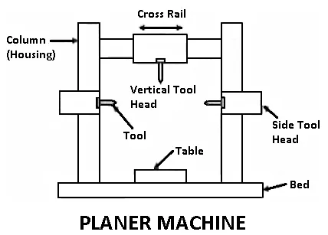

Slide 16
Slotter Machine
Slotting machine is basically a vertical axis shaper. Thus the workpieces, which cannot be conveniently held in shaper, can be machined in a slotter.
Generally, keyways, splines, serrations, rectangular grooves and similar shapes are machined in a slotting machine.
The stroke of the ram is smaller in slotting machines than in shapers to account for the type of the work that is handled in them.

Slide 17
